Slide 1
Formal Definition of NFA
A DFA is a 5-tuple (Q, Σ, q₀, T, δ) where
Q is a finite set of states
Σ is an alphabet
q₀ ∈ Q is the start state
T ⊆ Q is the set of accept states
δ : Q x Σ → Q is transition function
An NFA is a 5-tuple (Q, Σ, q₀, T, δ) where
Q is a finite set of states
Σ is an alphabet
q₀ ∈ Q is the start state
T ⊆ Q is the set of accept states
δ : Q x (Σ U {ε}) → 2^{Q} is transition function

Slide 2
Kleene’s Theorem
The following are equivalent for any language L
There is a DFA for L
There is an NFA for L
There is an RE for L
If L has a DFA/NFA/RE we say it is regular

Slide 3
Proof of Kleene’s Theorem
DFA
NFA
RE
We need to show how to make four different conversions

Slide 4
DFA to NFA
Any DFA is also an NFA

Slide 5
NFA to DFA
NFAs are nondeterministic only if you focus on only one trace at a time through the automata and think in terms of backtracking
Instead, think of all the NFA states that the automata can be in at once as a single meta-state in a DFA
Use the transitions between the states of the NFA to define the transitions between the meta-states of the DFA

Slide 6
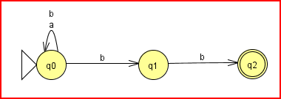
NFA to DFA
Begin DFA with meta-state corresponding to initial state of NFA plus any states reachable with epsilon transitions. (This is the initial DFA state.)
Repeat the following until there’s nothing more to do:
Pick a symbol and a meta-state in the DFA. Find all the states reachable from the corresponding NFA states via the symbol (plus epsilon transitions). Use this information to add (if necessary) a new meta-state and transition to the DFA
Any meta-state that contains a final NFA state is a final DFA state

Slide 7
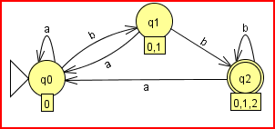
NFA to DFA

Slide 8
NFA to RE
View labels on transitions as regular expressions instead of alphabet symbols
Gradually eliminate states and transitions while creating new transitions labeled with ever more complicated regular expressions
In the end you’ll have a single transition between an initial state and a final state. The label on the transition is the result of the conversion.

Slide 9
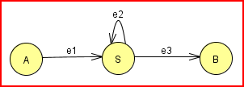

NFA to RE
Add states and epsilon transitions (if necessary) so that the NFA has an initial state with no in-transitions and a unique final state with no out-transitions.
Repeat the following until there are only two states and one transition left:
If there are multiple transitions between any pair of states, replace with a single transition labeled with the “or” of the labels of the replaced transitions.
Pick a non-initial/non-final state S to eliminate. For every pair of states A and B where there’s a transition from A to S to B, do this elimination transformation:

Slide 10
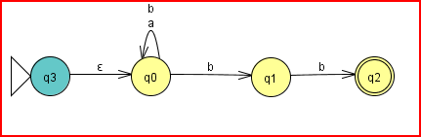
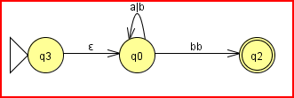
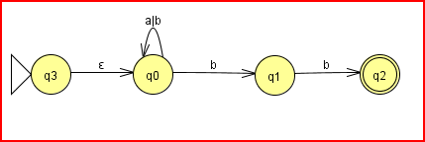

NFA to RE

Slide 11




RE to NFA
Regular expressions are defined recursively.
For each type of regular expression, transfom its constituent parts into NFAs and then combine to obtain the desired NFA
a
E F
...
...
...
...

Slide 12
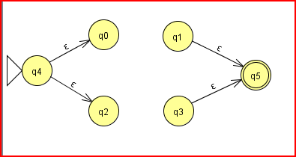
RE to NFA
...
...
E | F
...
...

Slide 13
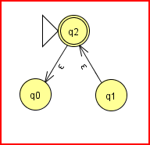
RE to NFA
...
E*
...

